Slide 1

OpenMP for Python
Caleb Huck

Slide 2

Organization
Add later

Slide 3
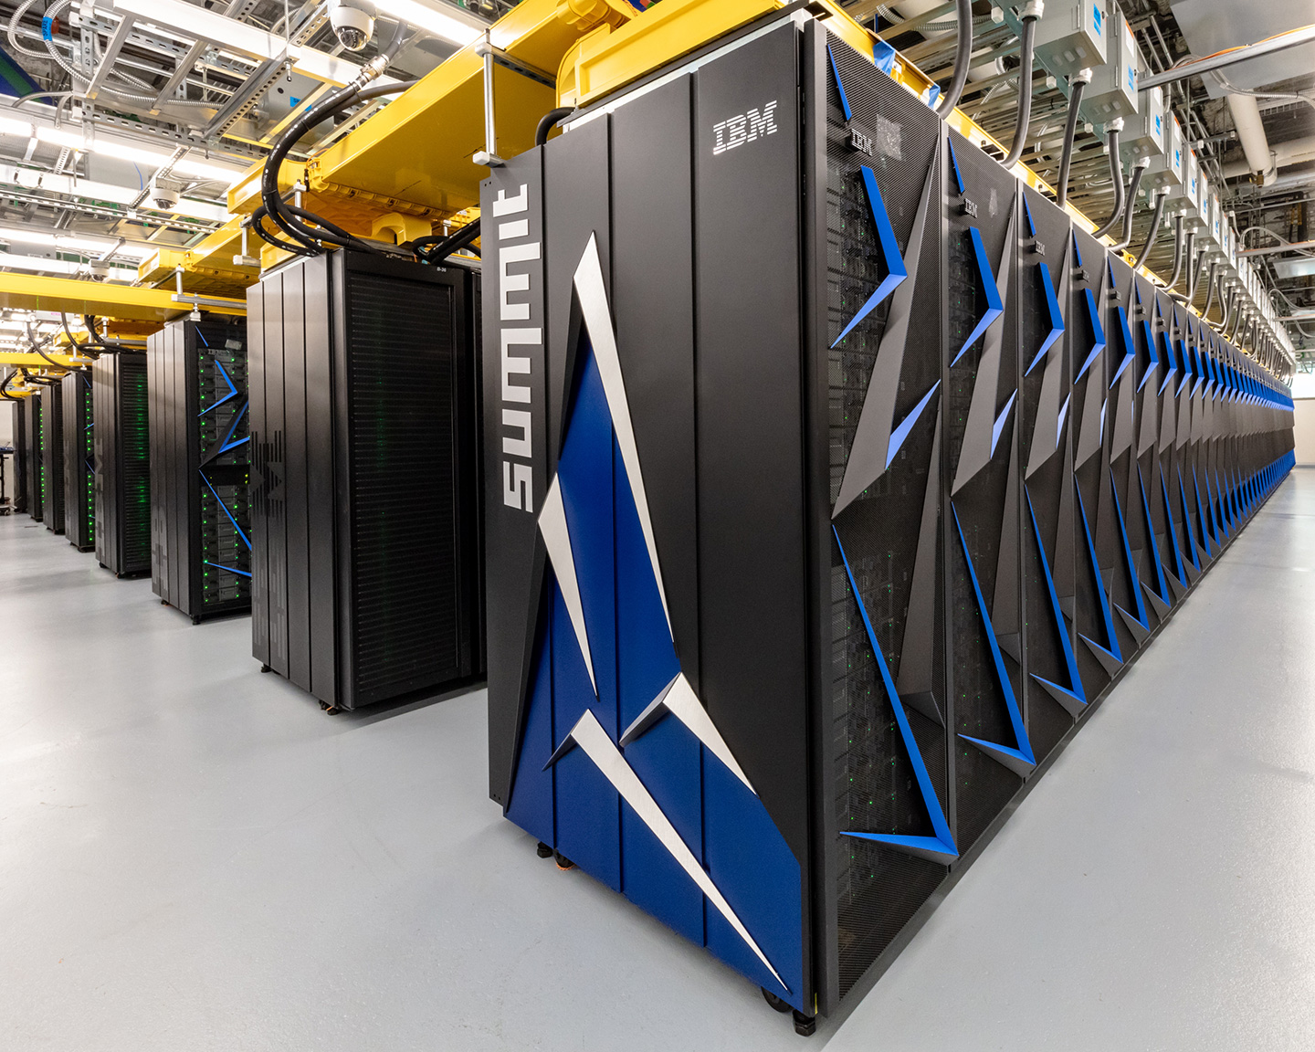

Background
Multi-core computing has become the standard
Essentially all hardware is parallel
Core 1
Core 2
Core 3
Core 3
Core 4
https://www.vecteezy.com/vector-art/376554-laptop-computer-isolated-on-a-white-background
https://www.olcf.ornl.gov/summit/

Slide 4



Background
Industry
Demand for parallel programming skills
Academia
Changing accreditation standards
Elective Requirement
Work in research community to accomplish this [1-12]
https://www.vecteezy.com/free-vector/programmer
https://www.vecteezy.com/free-vector/school
https://www.vecteezy.com/free-vector/university
Notes:
Everything is parallel interms of hardware
Computing curricula is still emphasizing serial coding and thinking
*emphasize early – start thinking in parallel
*acm 2013 curriculum recommendation and abet has included pdc as required
*all programs – not just hpc

Slide 5
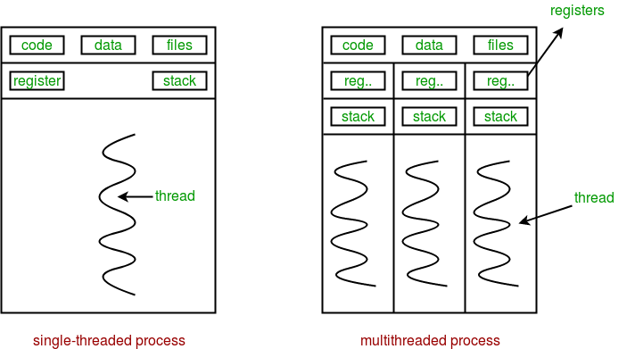
Background (DELETE)
Methods of Parallelism
SIMD
Multiprocessing
Shared-memory Multithreading
https://www.geeksforgeeks.org/multithreading-python-set-1/
Thread 0
Thread 0
Thread 1
Thread 0
Thread 2
Notes:
Everything is parallel interms of hardware
Computing curricula is still emphasizing serial coding and thinking
*emphasize early – start thinking in parallel
*acm 2013 curriculum recommendation and abet has included pdc as required
*all programs – not just hpc

Slide 6

Background
iPDC (Integrating Parallel and Distributed Computing in Introductory Programming Classes)
Provide training and resources
Workshops
Lecture
Hands on exercises
Modules
Programming
“Unplugged”
https://www.tntech.edu/ocm/marketingtoolkit/assets.php

Slide 7
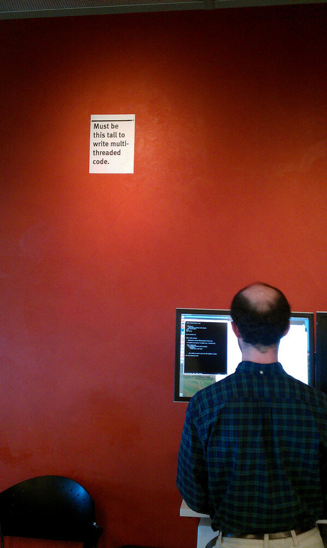
https://bholley.net/blog/2015/must-be-this-tall-to-write-multi-threaded-code.html

Slide 8
OpenMP
Open Multi-Processing
Shared-memory parallel library
1997 - present
Removes responsibility for thread creation and management from programmer
Abstract preprocessor-level directives and clauses
Rewrites source code before compiler sees it
Runtime library
https://www.geeksforgeeks.org/multithreading-python-set-1/
Thread 0
Thread 0
Thread 1
Thread 0
#pragma omp parallel
{
/*parallel code block*/
}
Thread 2
Notes:
* Add history of openmp

Slide 9
Problem
Top three languages used in teaching early CS:
C/C++
Java
Python
OpenMP only supports FORTRAN, C, C++
Several Java implementations with varying usability (covered later)
No implementations in Python

Slide 10
Contribution
Core OpenMP functionality in Python
Directives and clauses
Runtime library
Teaching, not performance
Concurrency
Parallelism
Speedup
Efficiency
Synchronization
Etc.
Thread 0
Thread 0
Thread 1
Thread 0
Thread 2

Slide 11
OpenMP Core
Directives | Clauses | Runtime Functions
parallel | num_threads | omp_get_thread_num()
for | reduction | omp_get_num_threads()
parallel for | shared | omp_get_wtime()
barrier | private
critical | firstprivate
 | lastprivate

Slide 12
Related Work
Jomp [14]
Released in 2000
Java 1.x and OpenMP version 1.0
Two phase compilation (.jomp .java .class)
Pyjama [15]
Released in 2013
Java 7 and OpenMP 4.x
Two phases combined to single application (.java .class)
Omp4J [16]
Released in 2015
Java 8 and OpenMP 4.x
Similar to Pyjama
No runtime library

Slide 13
Design
Design Goals
Easy to download, install, and use
Early students and professors
Provide helpful error messages for debugging
Integrate with IDEs
Follow original OpenMP syntax/style

Slide 14
Python Obstacles
https://www.vecteezy.com/free-vector/barrier

Slide 15


Python-Related Obstacles
Problem
Solution
CPython GIL (Global Interpreter Lock)
Jython Interpreter (No GIL)

Slide 16
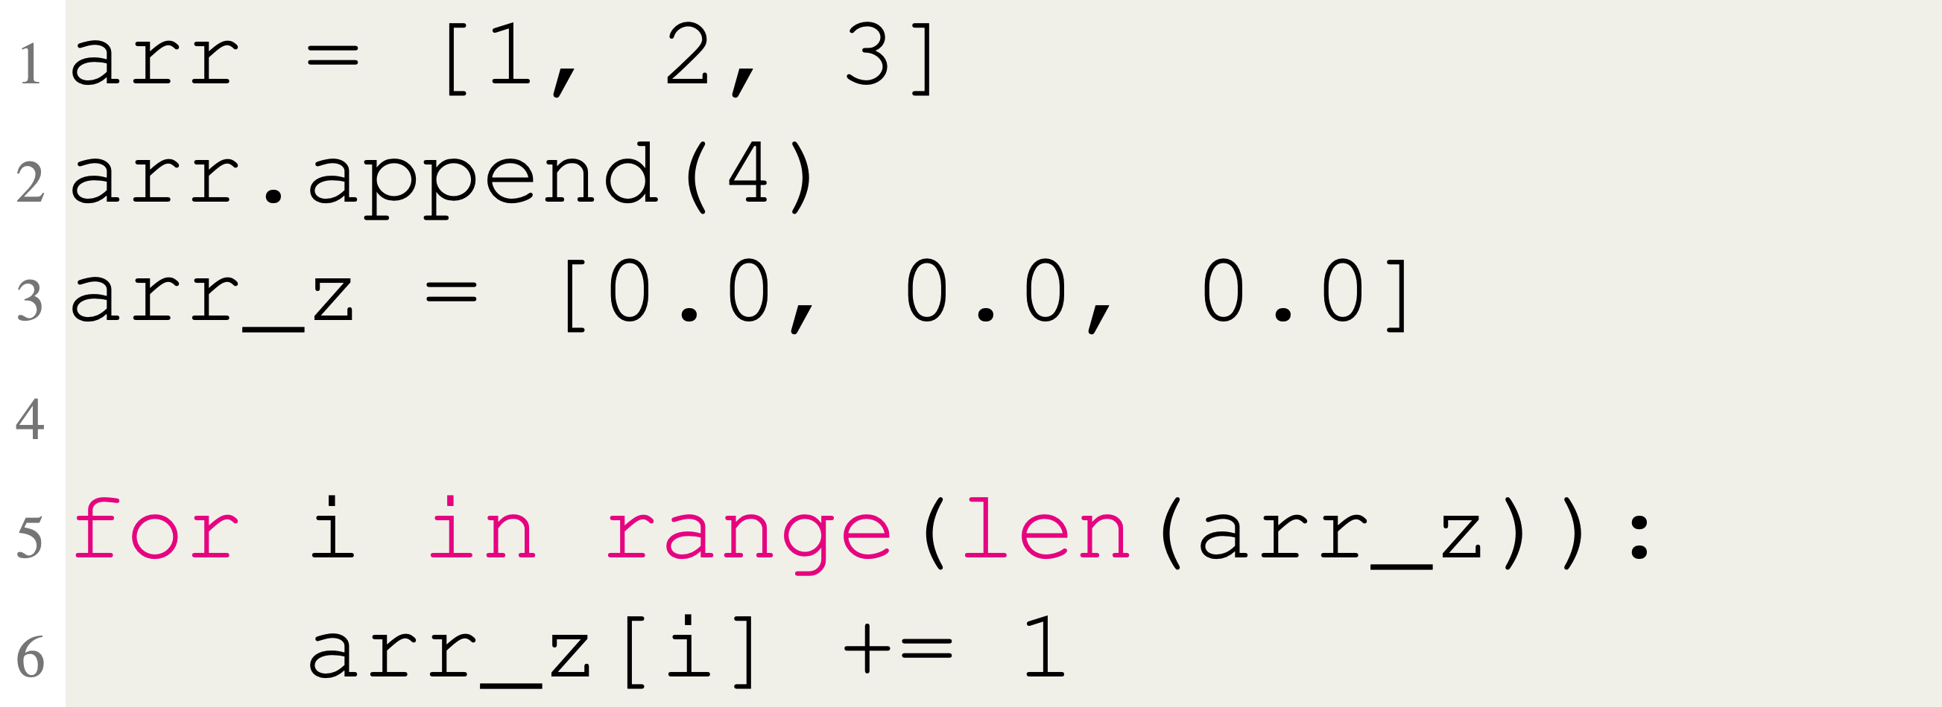
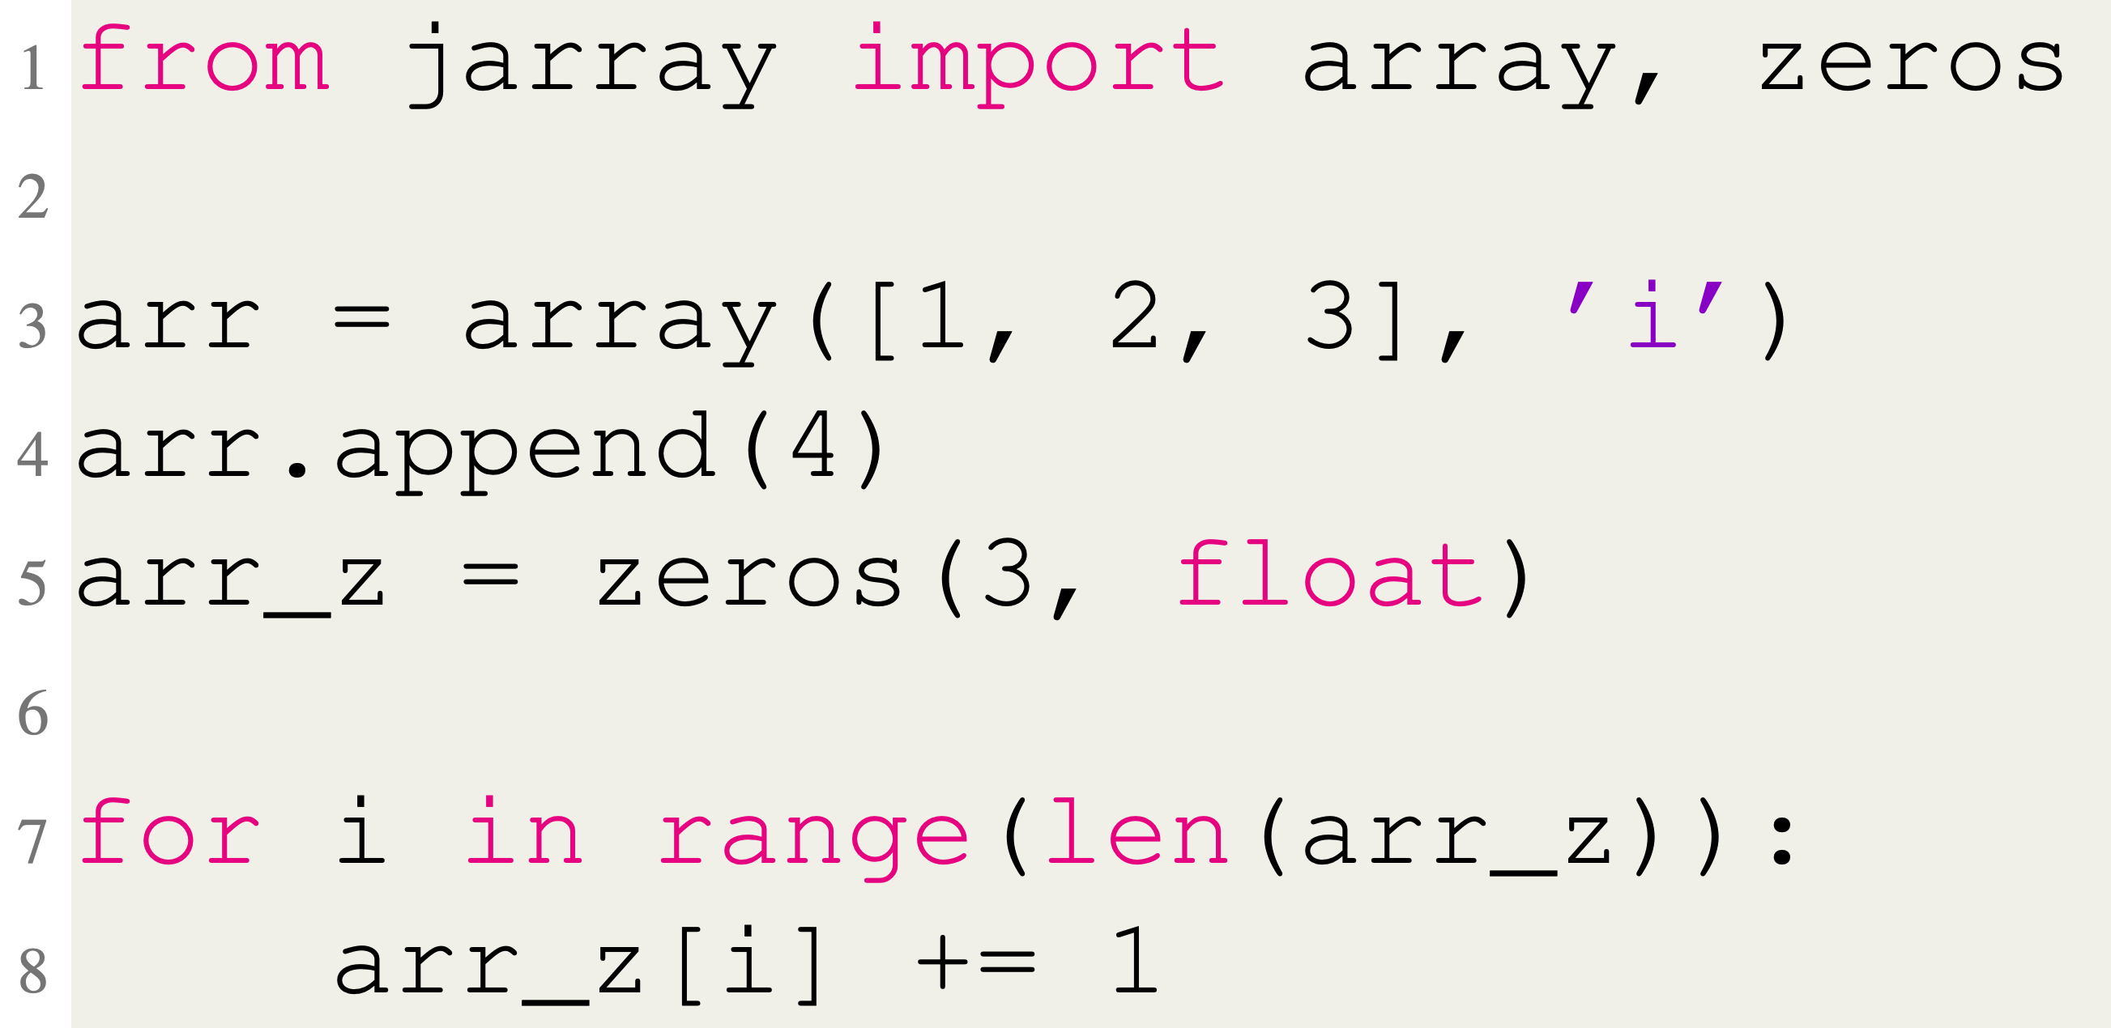
Python-Related Obstacles
Problem
Solution
jarray.array & jarray.zeros
Data Structures

Slide 17
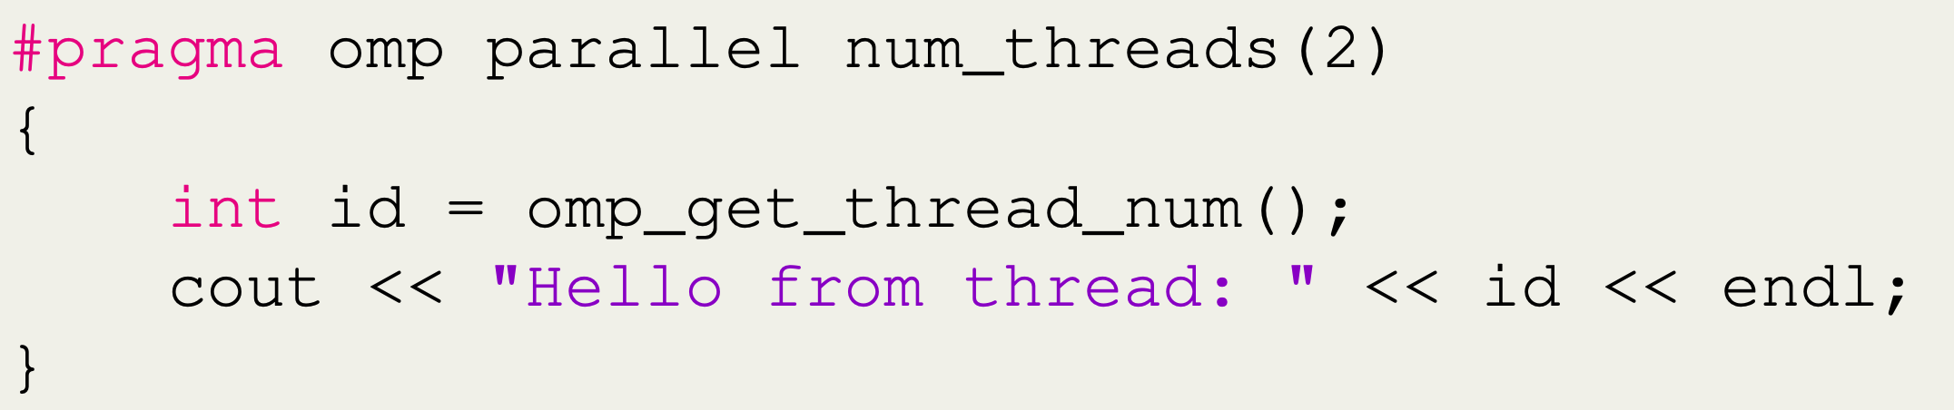
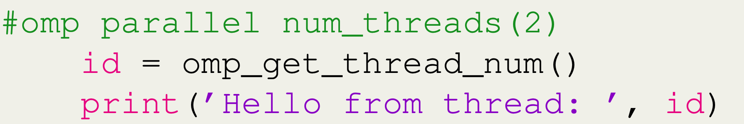
Python-Related Obstacles
Problem
Solution
Modify Python syntax
Scope
C++
Python
*Breaks compatibility with standard Python

Slide 18
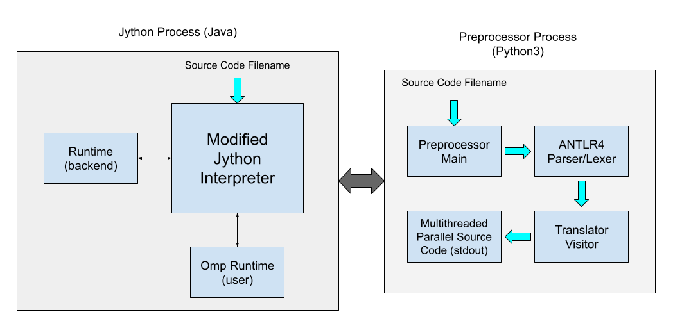
Software Architecture
Jython (Java) Process
Modified to call preprocessor before executing code
Backend runtime
User runtime
Preprocessor (Python 3) Process
ANTLRv4 Parser Generator
Visitor pattern
OpenMP Code Threaded Code
Transformed code/error printed to stdout

Slide 19
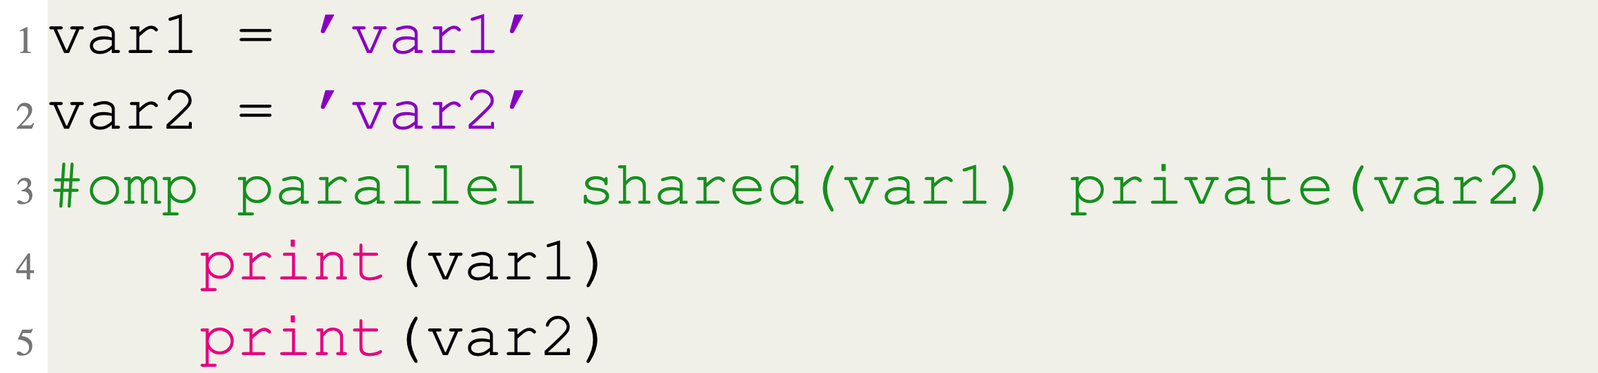
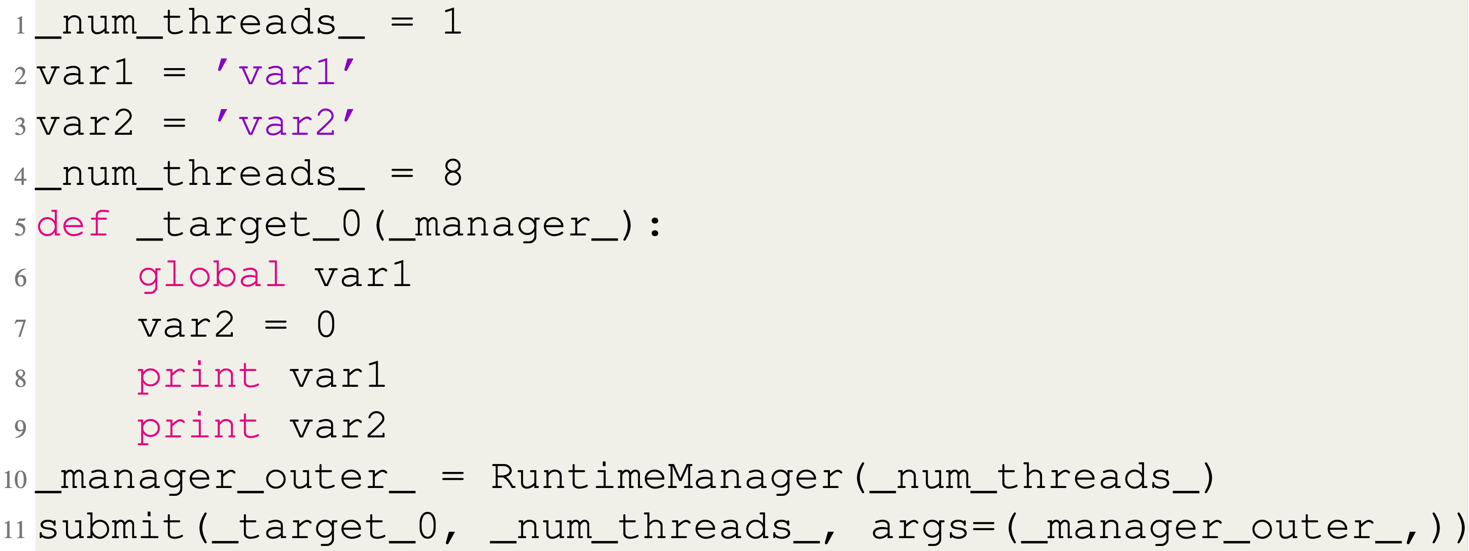
Source-to-source Translation
OpenMP Input Code
Preprocessor Output Code

Slide 20
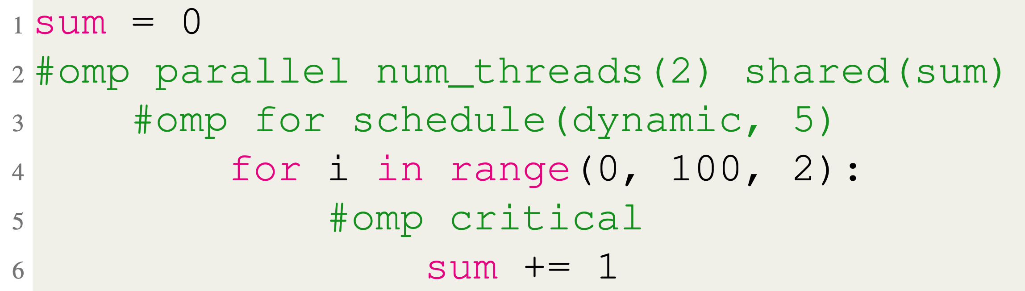
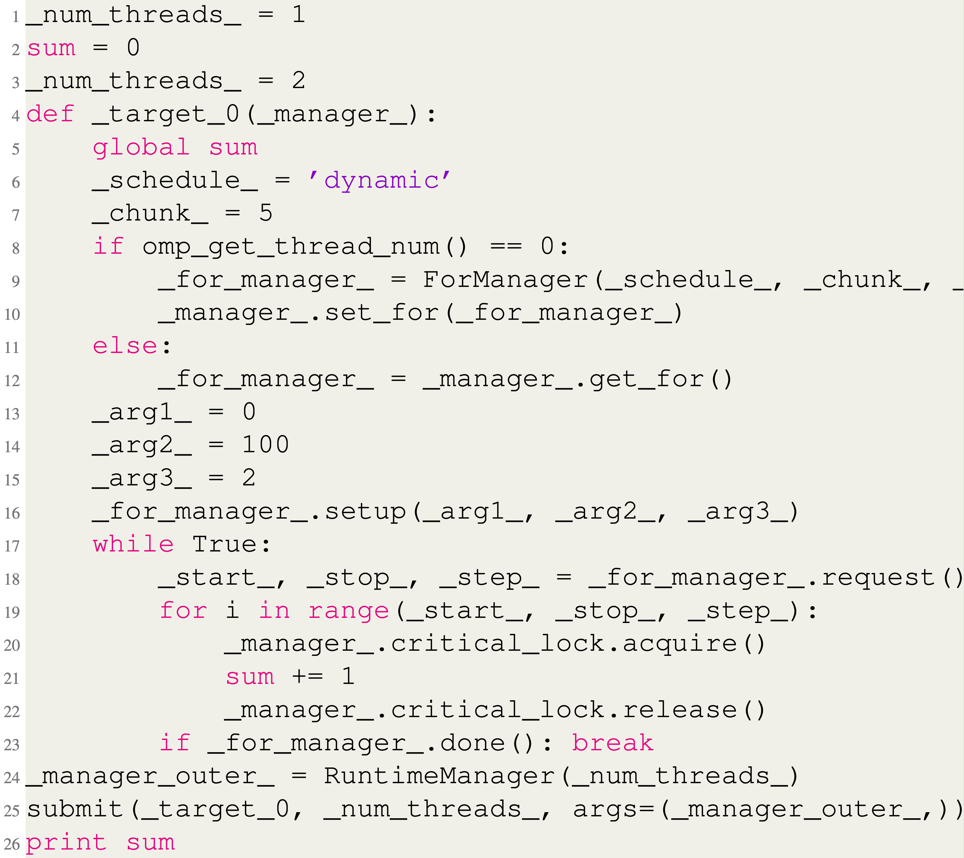
Source-to-source Translation
OpenMP Input Code
Preprocessor Output Code

Slide 21
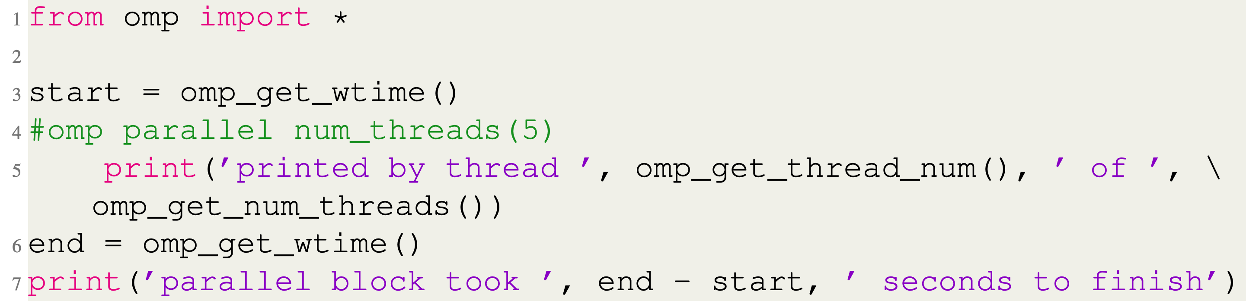
Runtime API

Slide 22
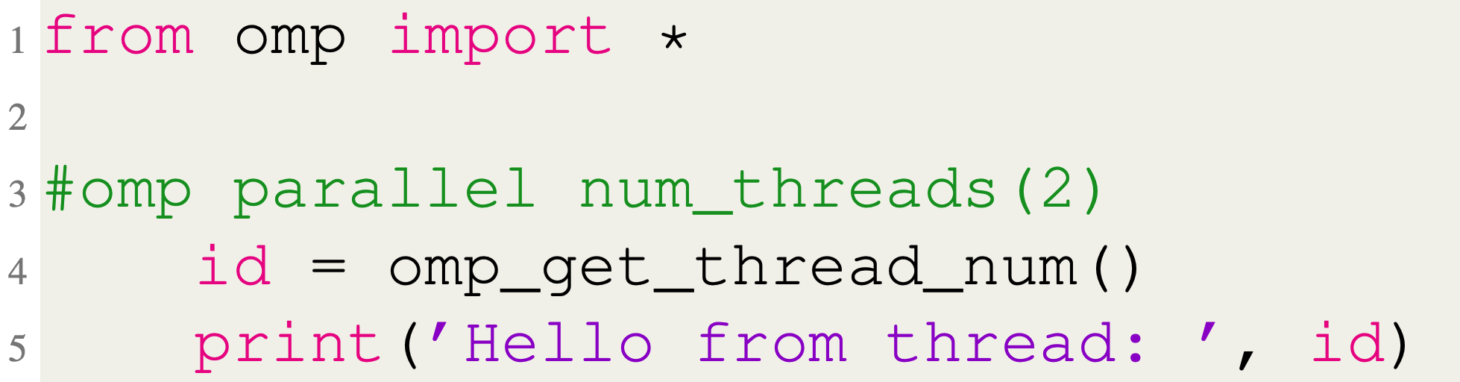
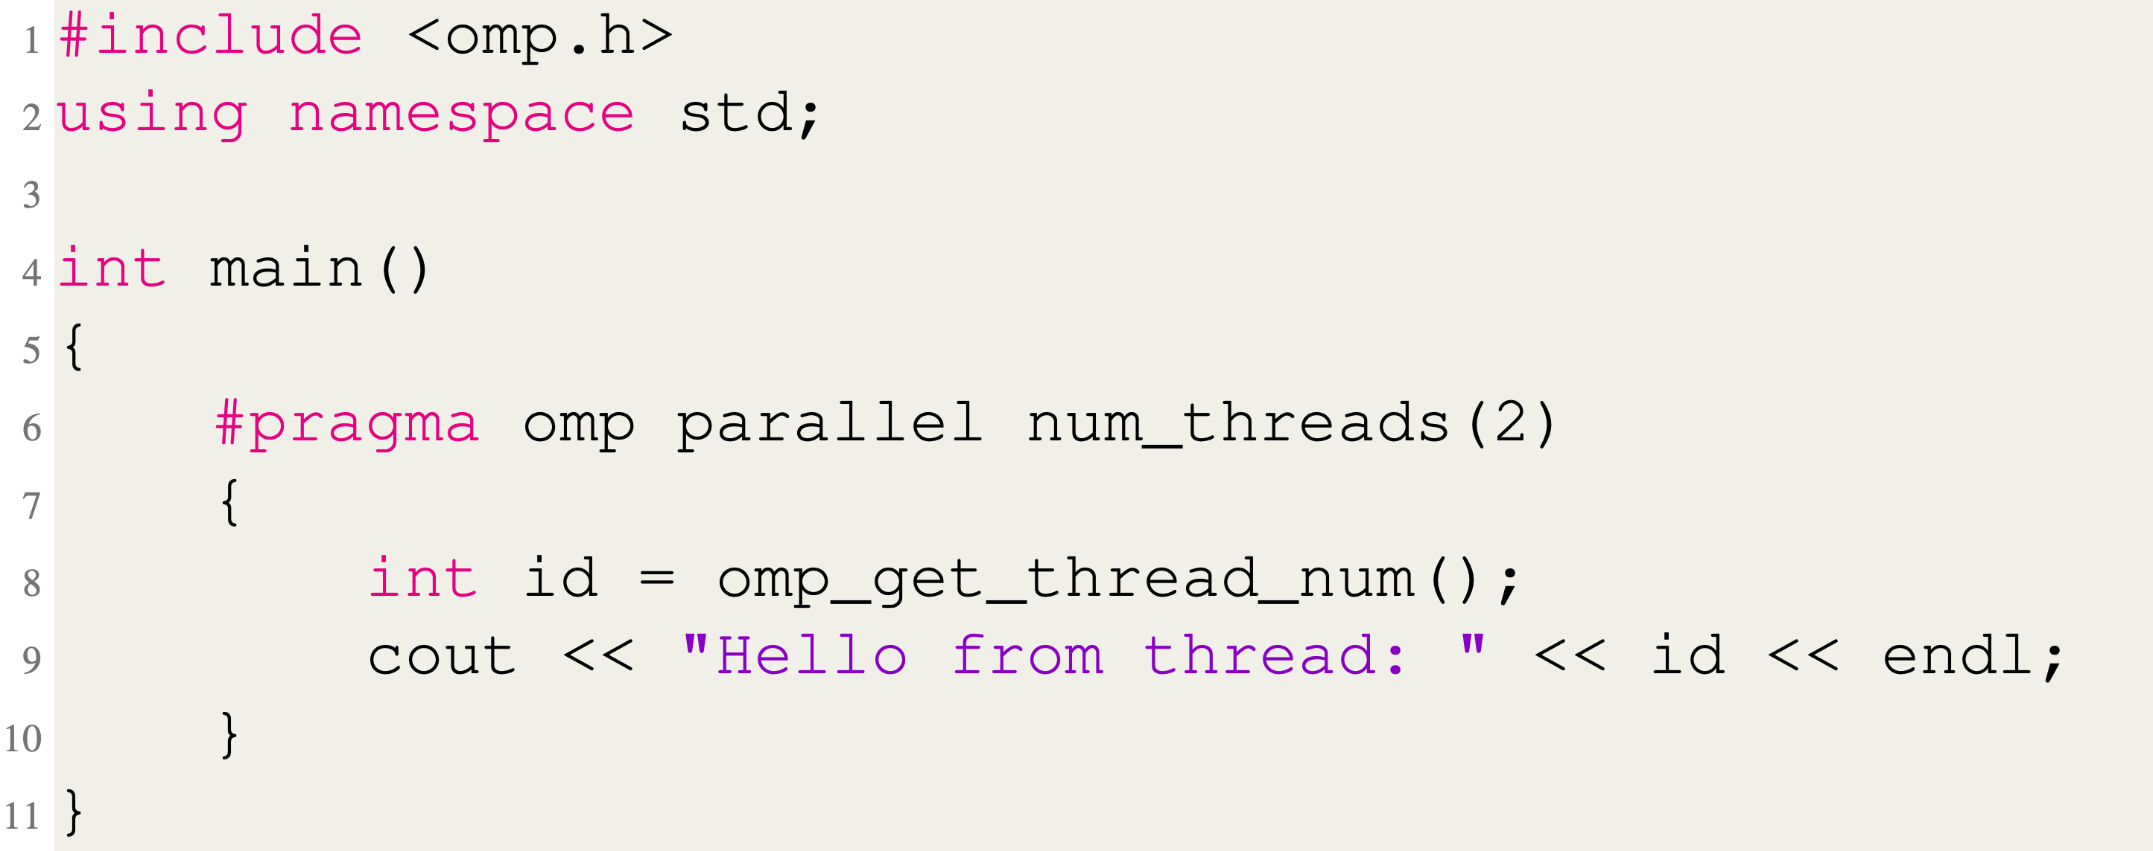
Parallel Directive
Python
C++

Slide 23
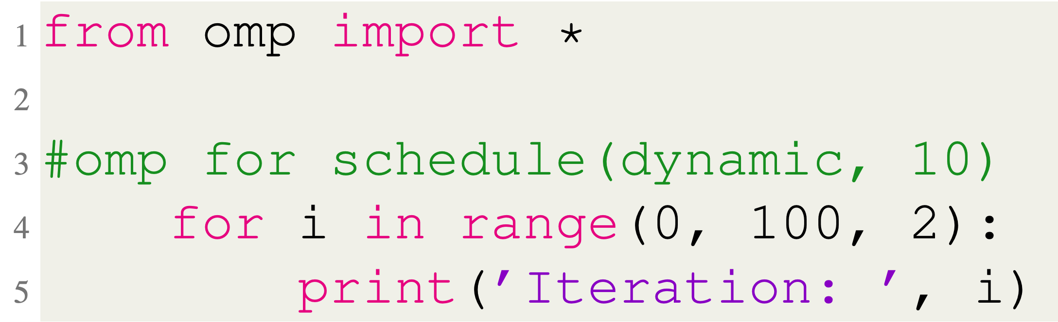
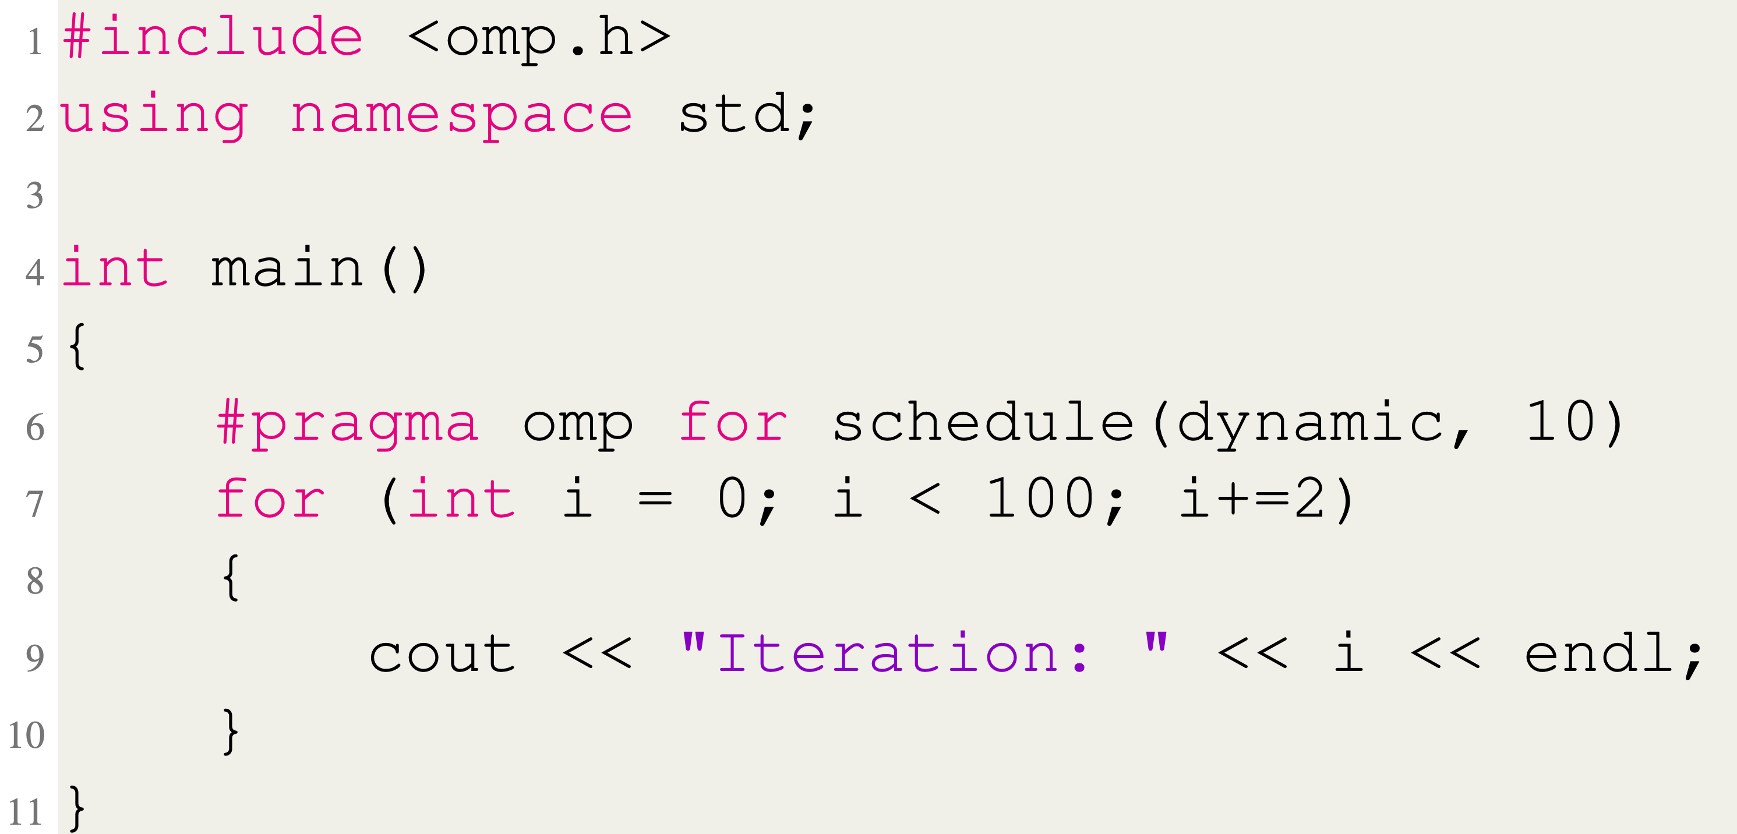
For Directive
Python
C++

Slide 24
Performance
Microbenchmarks
Windows 10 machine
6 cores/12 hardware threads
Random integers
Average of 20 runs
* Results obtained using same OpenMP block for all runs, including 1 thread

Slide 25
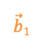
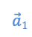
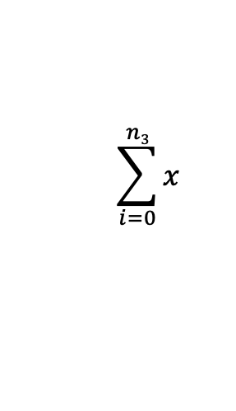
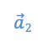
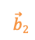
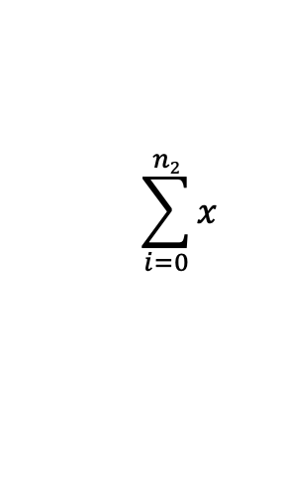
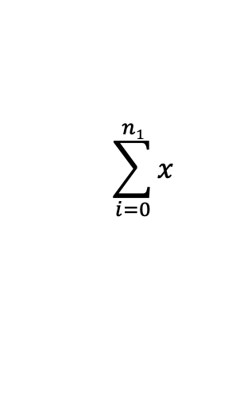
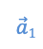
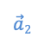
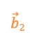

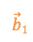
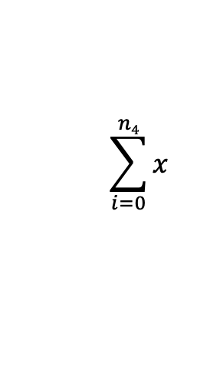
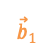
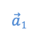
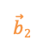
Performance
Microbenchmarks
N x N Matrix Multiplication
Matrices stored in jarray
Row wise partitioning
1, 2, 4, 8, and 12 threads
Parallel Sum
Integers stored in jarray
Divided evenly among threads
1, 2, 4, 8, and 12 threads
$$\vec{b}1$$
$$\vec{b}2$$
$$\sum_{i=0}^{n1}{x}$$
$$\sum_{i=0}^{n2}{x}$$
$$\sum_{i=0}^{n3}{x}$$
$$\sum_{i=0}^{n4}{x}$$
↙
↙
.
.
$$\vec{a}1$$
↙
1
7
.
1
7
=
$$\vec{a}1$$
$$\vec{b}1$$
$$\vec{a}1$$
$$\vec{b}2$$
$$\vec{a}2$$
.
.
↙
2
4
2
4
$$\vec{a}2$$
$$\vec{b}1$$
$$\vec{a}2$$
$$\vec{b}2$$
A
B
C

Slide 26
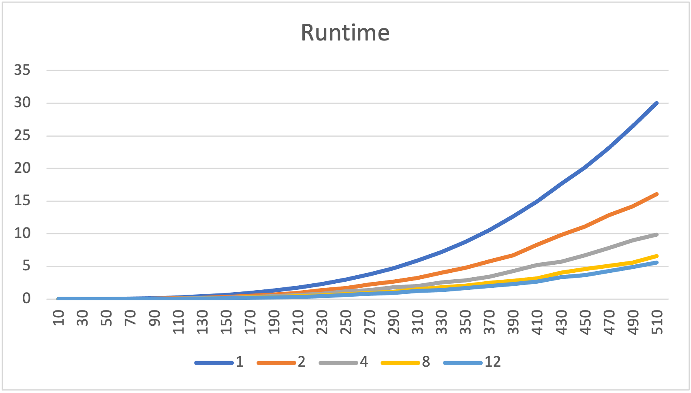
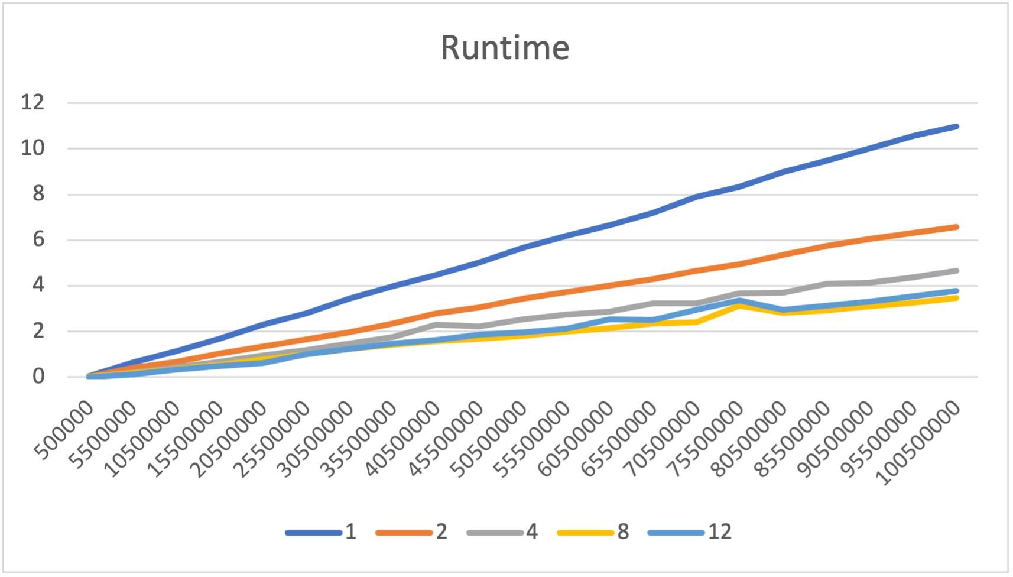
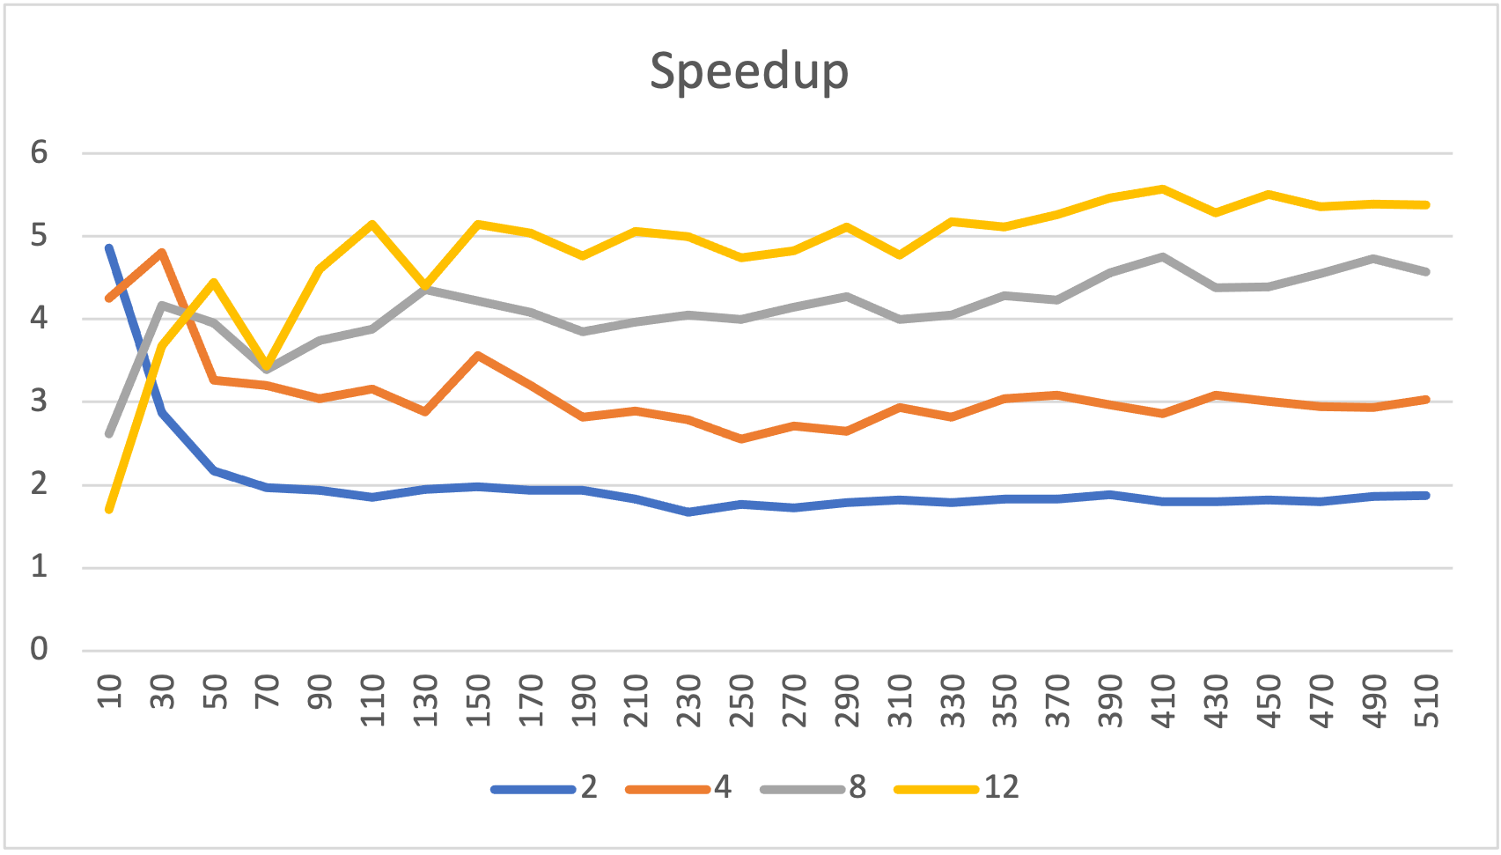
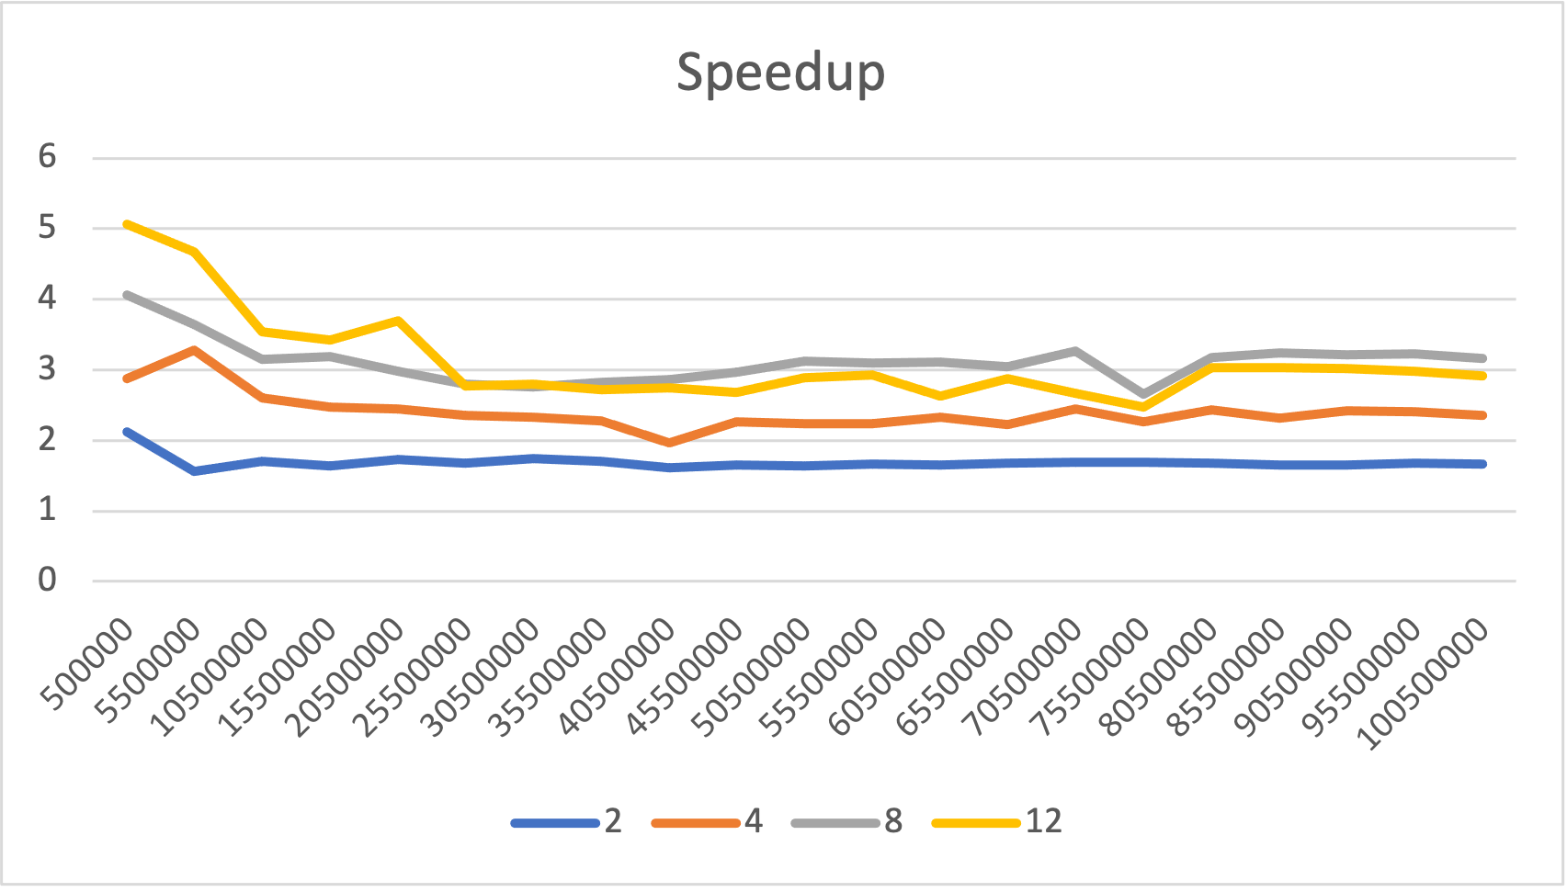
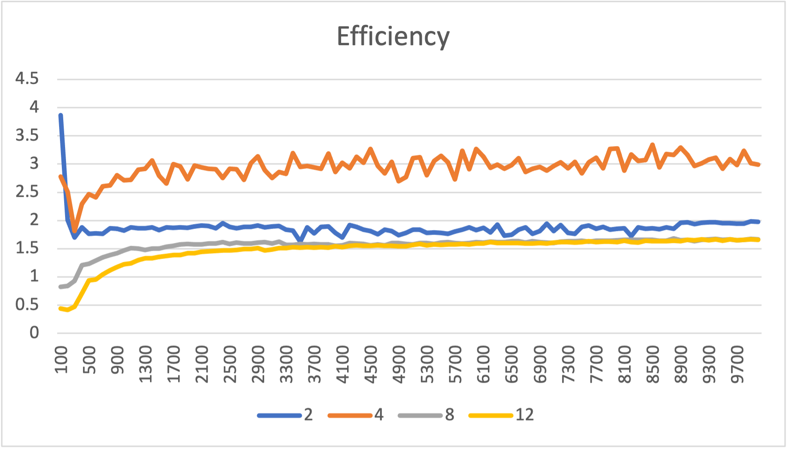
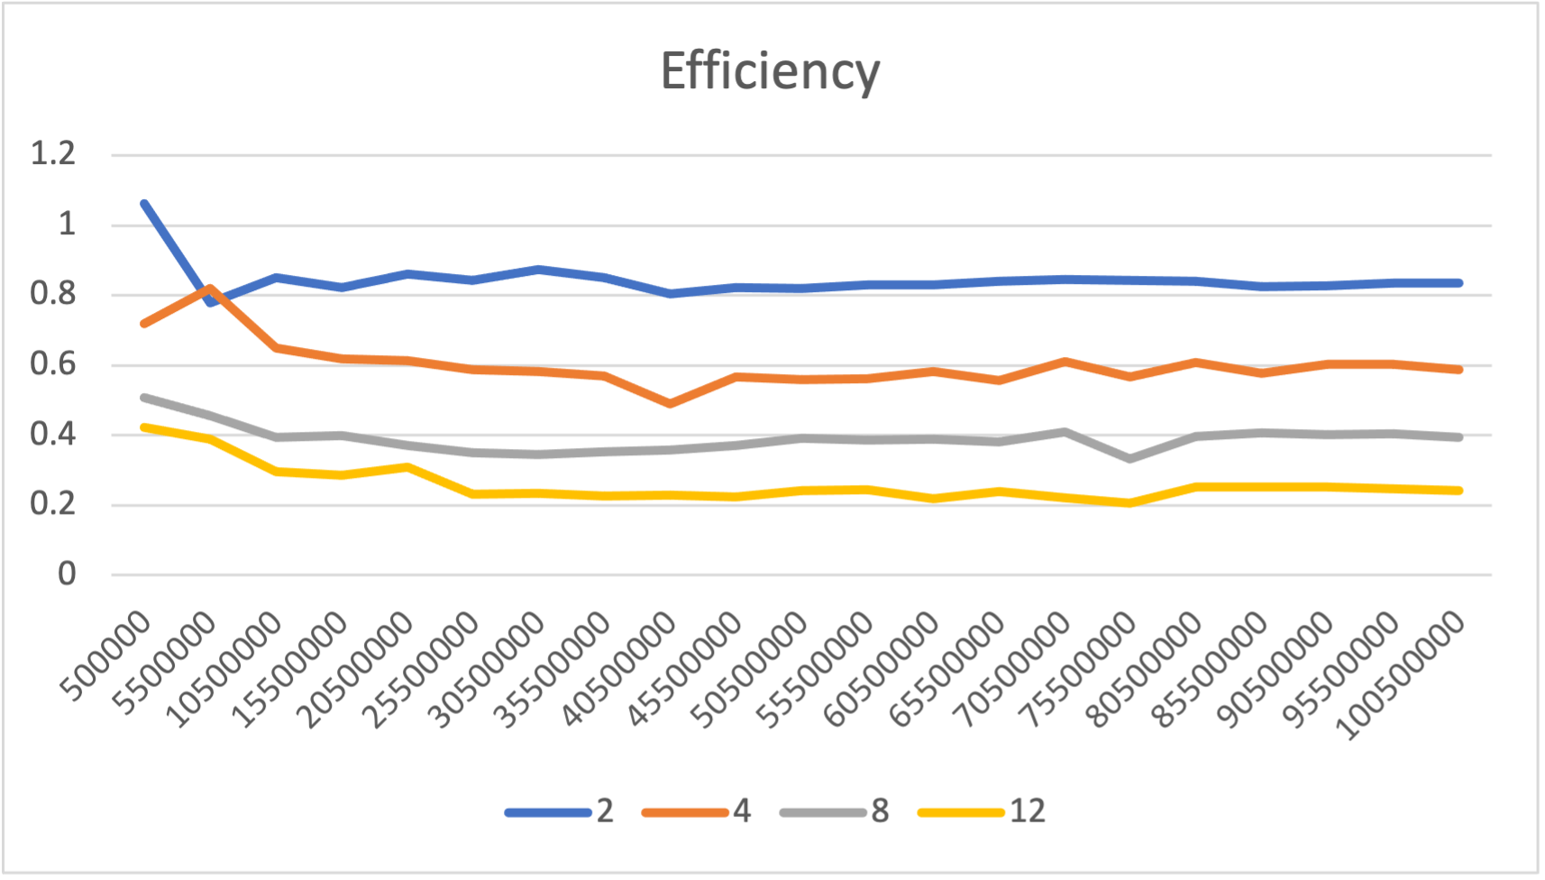
Parallel Matrix Multiplication
Parallel Sum

Slide 27
Limitations
Task parallelism

Slide 28
Conclusion and future work
* just core – can add more
Havent worked with ides
Robust testing
Core directives, clauses, functions implemented
Fit OpenMP style/syntax to Python conventions
Tested our solution with n x n matrix multiplication
Results adequate for teaching parallel concepts

Slide 29
Questions?

Slide 30
References
[1] D. J. Ernst and D. E. Stevenson, “Concurrent cs: preparing students for a multicore world,” in Proceedings of the 13th annual conference on Innovation and technology in computer science education, pp. 230–234, 2008.
[2] Y. Ko, B. Burgstaller, and B. Scholz, “Parallel from the beginning: The case for multicore programming in thecomputer science undergraduate curriculum,” in Proceeding of the 44th ACM technical symposium on Computer science education, pp. 415–420, 2013. [3] J. C. Adams, “Injecting parallel computing into cs2,” in Proceedings of the 45th ACM technical symposium on Computer science education, pp. 277–282, 2014.
[4] B. Neelima and J. Li, “Introducing high performance computing concepts into engineering undergraduate curriculum: a success story,” in Proceedings of the Workshop on Education for High-Performance Computing, pp. 1–8, 2015.
[5] J. R. Graham, “Integrating parallel programming techniques into traditional computer science curricula,” ACM SIGCSE Bulletin, vol. 39, no. 4, pp. 75–78, 2007.
[6] R. Brown and E. Shoop, “Csinparallel and synergy for rapid incremental addition of pdc into cs curricula,” in 2012 IEEE 26th International Parallel and Distributed Processing Symposium Workshops & PhD Forum, pp. 1329–1334, IEEE, 2012.
[7] R. Brown and E. Shoop, “Modules in community: injecting more parallelism into computer science curricula,” in Proceedings of the 42nd ACM technical symposium on Computer science education, pp. 447–452, 2011.
[8] J. Adams, R. Brown, and E. Shoop, “Patterns and exemplars: Compelling strategies for teaching parallel and distributed computing to cs undergraduates,” in 2013 IEEE International Symposium on Parallel & Distributed Processing, Workshops and Phd Forum, pp. 1244– 1251, IEEE, 2013.
[9] W. Ahmed, M. M. Muthaher, and J. M. Basheer, “Introducing high performance computing (hpc) concepts in institutions with an absence of hpc culture,” in 2013 Sixth International Conference on Contemporary Computing (IC3), pp. 274–277, IEEE, 2013.

Slide 31
References
[10] S. A. Bogaerts, “Limited time and experience: Parallelism in cs1,” in 2014 IEEE International Parallel & Distributed Processing Symposium Workshops, pp. 1071–1078, IEEE, 2014.
[11] B. L. Kurtz, C. Kim, and J. Alsabbagh, “Parallel computing in the undergraduate curriculum,” in Proceedings of the twenty-ninth SIGCSE technical symposium on Computer science education, pp. 212–216, 1998.
[12] G. Lu, J. Xu, J. Liu, B. Dai, S. Gui, and S. Zhan, “Integrating parallel and distributed computing topics into an undergraduate cs curriculum at uestc,” in 2015 IEEE International Parallel and Distributed Processing Symposium Workshop (IPDPSW), (Los Alamitos, CA, USA), pp. 782–787, IEEE Computer Society, may 2015. 13
[13] S. Ghafoor and M. Rogers, “ipdc workshop.” https://www.csc.tntech.edu/ pdcincs/.
[14] J. M. Bull and M. E. Kambites, “Jomp—an openmp-like interface for java,” in Proceedings of the ACM 2000 conference on Java Grande, pp. 44–53, 2000.
[15] N. Giacaman and O. Sinnen, “Pyjama: Openmp-like implementation for java, with gui extensions,” in Proceedings of the 2013 International Workshop on Programming Models and Applications for Multicores and Manycores, pp. 43–52, 2013.
[16] P. Belohl ˇ avek, “Openmp for java,” 2015.

Slide 32
Image References
Thread stacks - Super computer -

